Slide 1
Desktop Object Identification and Tracking
Kevin DuCharme &
Max Li
Notes:
Hello and welcome all to our presentation. We are Kevin and Max and today we will be talking to you about out project, desktop object identification and tracking.

Slide 2
Introduction

Slide 3
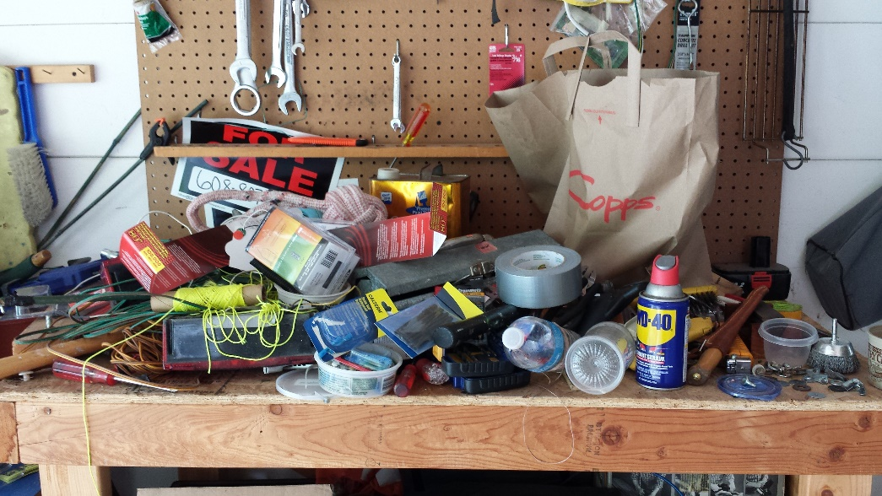

Motivation
The main motivation behind this project is the struggle of finding items on a heavily used desk. On an active workbench, tools and other useful items are frequently getting picked up, used, and placed down somewhere else. While good standard operating procedures will make sure all the parts end up where they're expected to be, it's very easy to quickly lose track of items.
Notes:
The main motivation behind this project is the struggle of finding items on a heavily used
desk. On an active workbench, tools and other useful items are frequently getting picked
up, used, and placed down somewhere else. While good standard operating procedures will
make sure all the parts end up where they're expected to be, it's very easy to quickly lose
track of items.

Slide 4
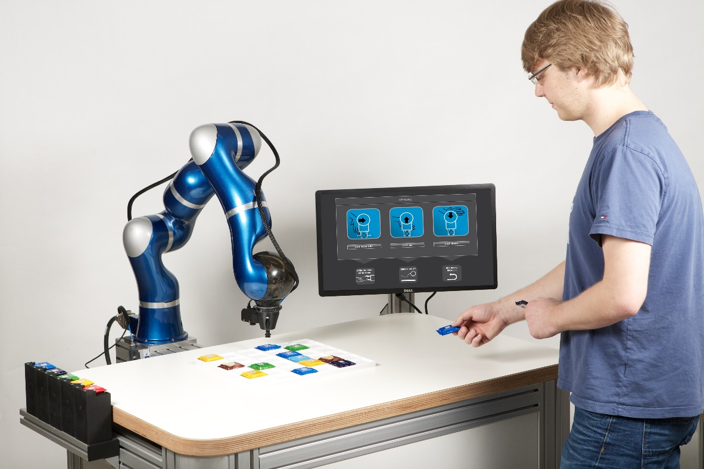
Introduction
Starting the framework for a lab assistant robot
Detect and track pre-trained common workbench items
Notes:
The goal of this project is to start the foundation of a lab assistant robot that has the
capability of tracking common items found on a workbench in pseudo real-time. When a
user queries the robot, it should be able to tell the user where a specific tool is, in a way
that would make sense to the user. Initially, the objects being identified would come from
a preset bank of objects that have been pre-trained. However, the end product will likely
have to be trainable on new objects by the user.
For this project, the main topic of focus is object tracking. After all, the rest of the
features are both fairly difficult (and thus time-consuming), and out of scope of the computer
vision task. As such, the goal is to be able to detect a number of different objects, identify
what they are, and track them as they move across a camera.

Slide 5
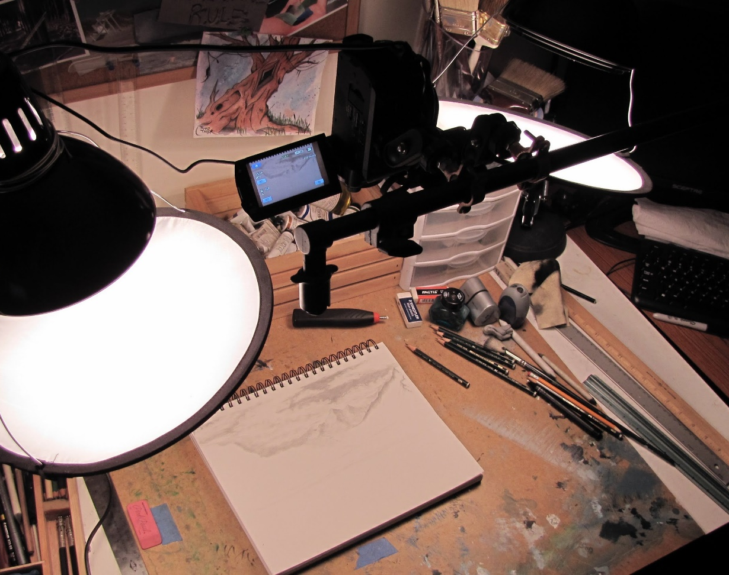
Desk Camera Configuration
Controlled Environment
Keep setup simple
Top-down viewing camera
Kept well-lit
Reduced clutter for initial implementation
Notes:
We wanted to control our environment to ease our ingress into the world of computer vision using deep learning networks. While later on this network can be refined to better handle clutter and various lighting conditions, we wanted to remove those distractions so that we could focus on the object detection and tracking aspect.

Slide 6
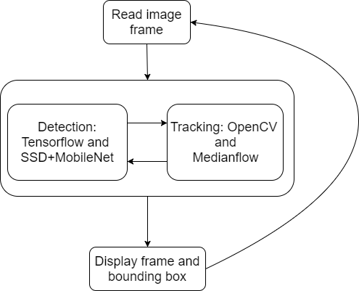
Code Structure
Python 3.5
Tensorflow 1.4
OpenCV 3.3 with extra modules (opencv-contrib)

Slide 7
Object Detection

Slide 8
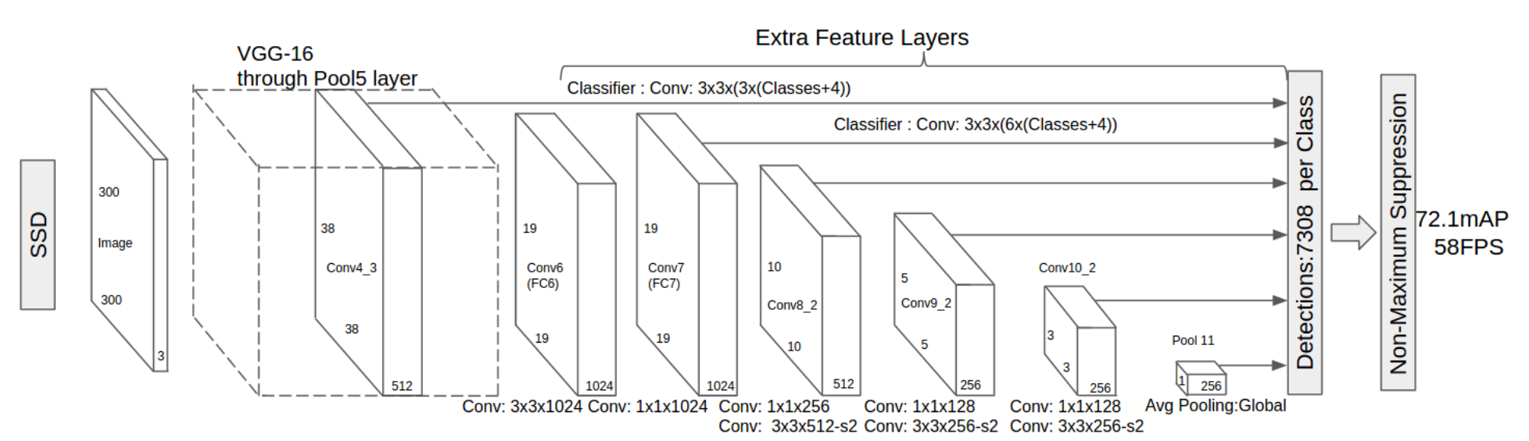
Single-Shot Detectors
Notes:
Single-shot detectors provide for faster detection at the cost of accuracy. It is a tradeoff worth making though for our pseudo ‘real-time’ application.
One of the reason why they gain their speed is because the input images are resized to a smaller resolution. This allows the different convolution layers that have multiple scaled feature maps to work through them quickly. The varied feature maps also help with handling objects with different sizes. Lastly, they are easy to train.

Slide 9
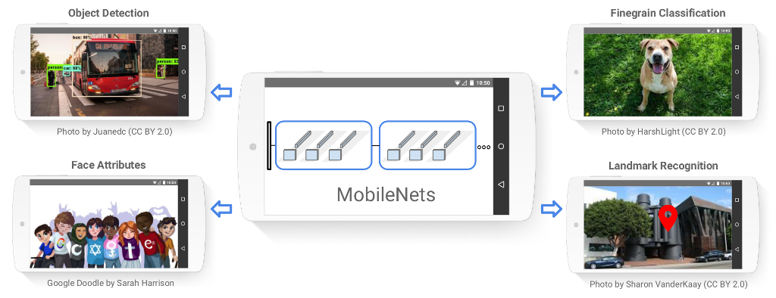
MobileNets
A. G. Howard et al, "MobileNets: Efficient Convolutional Neural Networks for Mobile Vision Applications," 2017.
Notes:
Google Inc. developed and announced MobileNets, a class of efficient models for mobile and embedded vision applications. It achieves this efficiency by using depth wise separable convolutions to build light weight deep neural networks.
The streamlined architecture brings applications like object detection and landmark recognition off of computers and onto lower resource devices like phones.
This approach falls inline with our intention to target a raspberry pi in the future.

Slide 10
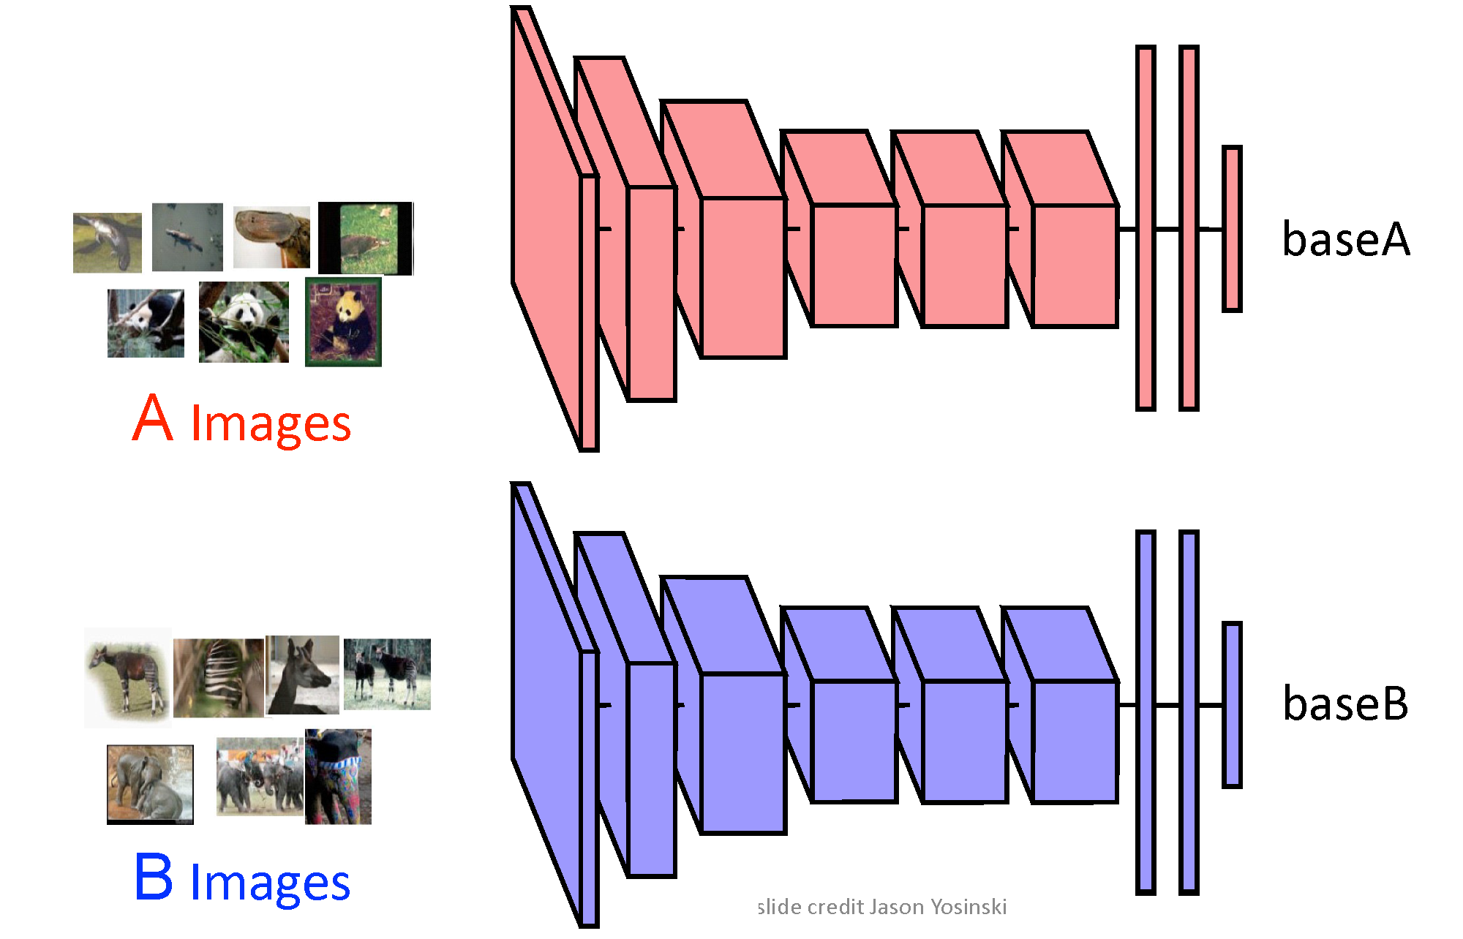
Transfer Learning
Notes:
Like many other applications in coding, neural networks are designed perfectly for reuse or transfer learning. Most deep learning applications use this approach instead of building a network from scratch every time.
The process consists of making modifications to pretrained models. Transfer learning can consist of reusing a single layer up to the whole network.
The network that we will be employing was trained on the COCO image dataset. We are reusing the entire structure, but changing the output layer for only 3 classes. The model has already defined feature details and a weight file that helps us load new images in and train for a fraction of the time to get our new output predictions.

Slide 11
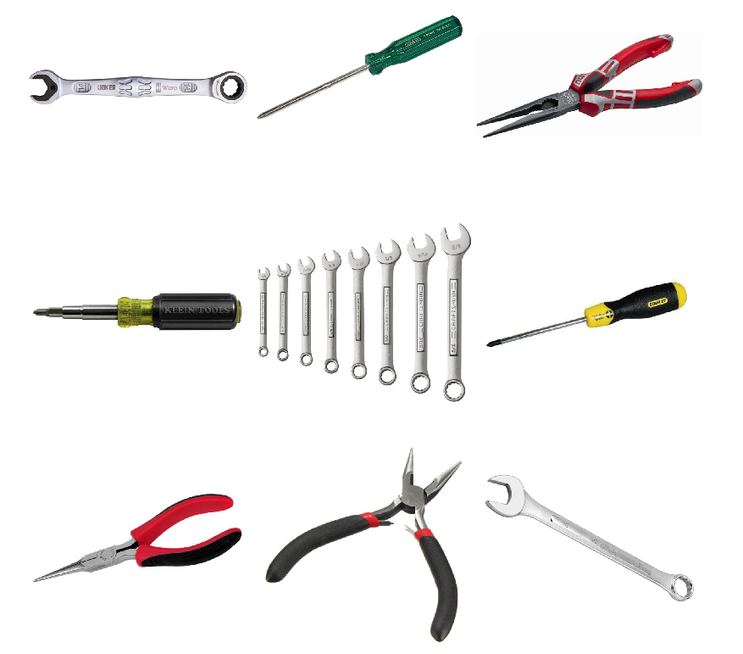
Gathering Training Set
The project was limited to three classes: Wrenches, Pliers, and Screwdrivers.
Each category contains ~150 sample images
Images are of various resolutions
Only data augmentation was scaling down high resolution images
Notes:
Creating your own dataset can be a time consuming and arduous process and because of that we limited this project to three classes: Wrenches, Pliers, and Screwdrivers. Using a combination of Google and Bing image searches, along with image-net.org, about 150 sample images was collected for each class. The images had a wide range of resolutions which helps with providing robustness to the trained model. During training, we did run into some memory issues due to some of the ridiculously large image resolutions. I am not sure who needs a 4k x 4k image of a pair of pliers, but our computers where none too happy with it. Instead of reducing our samples by removing the images, we resized the images down to something more manageable.

Slide 12
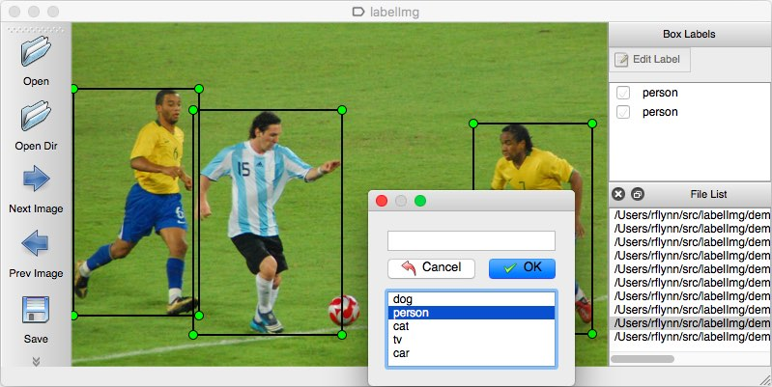
Bounding Box Labels
LabelImg (github/tzutalin)
Boundary box information was added for each item
Label was applied to the boundary box
Resulting XML files are converted to a tensorflow record file.
Tf.record
XML
Notes:
After we have our image dataset comes the tedious part - Labels and Boundary Boxes. The boundary boxes are used for regression training as ground truths to calculate Euclidean distances.
To generate these bounding boxes, we made use of LabelImg to open each photo, draw a box around the object, and then classify it. LabelImg then creates an xml file that contain the locations, sizes, and classification label for each box. In order to import these files by tensorflow, they are converted to tensorflow record files.

Slide 13
Training New Model
To train the model with the new data set four files were needed
tf.record file for each the training and testing dataset
.pbtxt file which maps the id number to a classification label
.config which contains the architecture for the neural network
Configuration file was based off of ssd_mobilenet_v1_pets.config with alterations
Changes number of classes from 90 to 3
Batch sized changes from 24 to 15
Redirected to our tf.record files and label map pb.txt file
Training ran for 13+ hours and completed 30,857 steps
tf.record
.pbtxt
.config
Notes:
Along with the tensorflow record files, we will also need a pbtxt file and configuration file.
The pbtxt file is used to link the id number from the neural network to a classification label.
Our classification labels of Wrenches, Pliers, and Screwdrivers have represented with an id of 1, 2, and 3 respectively.
We are using the ssd_mobilenet_v1_pets configuration file with a few tweaks. The number of classes was changed to 3, we reduced the batch size from 24 to 15 for hardware considerations, and lastly we had to point the configuration file to our dataset and label map.
The overall training time was 13+ hours as it ran overnight.
The next slide shows a video the results without tracking added.

Slide 14
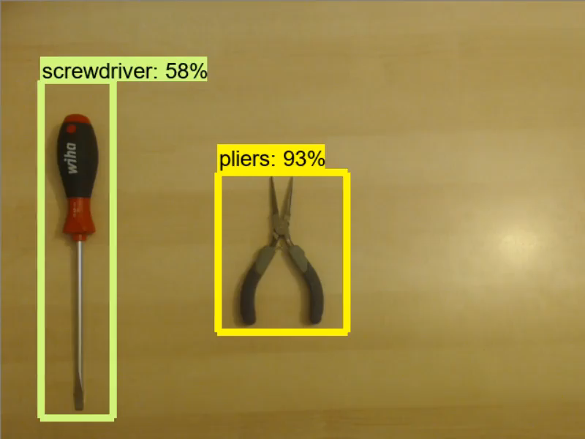
Real-time Detection (No Tracking)

Slide 15
Object Tracking

Slide 16
What is Object Tracking?
Object tracking is successively locating a known object in each frame of a video
Predefined bounding box is used as input to the tracker
Tracking is based on combining a motion model and an appearance model
Motion model is modeling the location and velocity of the object, like a Kalman filter
Appearance model is the model of the object to be tracked.
Frequently a classifier that is trained online
Notes:
What we’ve been talking about so far is object detection, which goes frame-by-frame and identifies if an object is in the frame, drawing a bounding box around each detected object. However, we also wanted to incorporate object tracking. Much like object detection, object tracking is about finding a specific object in a frame of video. However, object tracking assumes that you know the initial bounding box, and that an object will be in each successive frame. This allows for a variety of options that are not available for object detection.
In the context of real-time object tracking, algorithms are split up into two aspects, a motion model and an appearance model. The motion model keeps track of position and velocity of an object. The Kalman filter is a commonly used example of this.
The appearance model represents what the object to be tracked looks like. While a template could be used, most modern techniques use a classifier that is trained online to represent the object. This improves robustness when compared to using a template.

Slide 17
Why Track?
Tracking algorithms are usually faster than detection algorithms
Detection algorithms have to start with no prior information about an object.
Tracking algorithms know the previous location and velocity of an object.
Tracking algorithms start to drift over time from accumulating errors
Tracking can frequently handle occlusion better
Tracking preserves the identity of an object
Notes:
So with the results we’ve shown with object detection, why would a tracker be important to implement? There are three main reasons in doing so.
The first reason is that tracking algorithms are usually faster than detection algorithms. Detection algorithms, by their nature, do not assume anything about the object in question. Tracking algorithms, however, start off knowing a decent amount about the object, including its last position and velocity. With this information, trackers can come to a conclusion faster. However, over time, trackers tend to accumulate errors. This is frequently dealt with by periodically reinitializing tracked bounding boxes with an object detector, and this is what we have implemented.
Another reason to use tracking is because it can frequently handle occlusion better. In an intuitive sense, this can be thought of as the fact that trackers have more information about the object, and so are more robust than the detectors. This is not a motivating factor in our use case, and the tracker implemented does not seem to be better with occlusions than the detector.
The final reason for using a tracker is to preserve the identity of the object from frame to frame, something that a detector inherently is not capable of without some auxiliary way of keeping track.

Slide 18
Tracking Methods
OpenCV 3.3 has 6 types of online trackers:
AdaBoost-based:
Boosting: Uses AdaBoost, an ensemble learning method, to estimate the location.
Multiple Instance Learning (MIL): Similar to Boosting, but looks at a wider range of locations as positive identifications.
Kernelized Correlation Filters (KCF): Builds on MIL’s strategy of creating a large number of overlapping positive identifications.
Notes:
To decide which tracking algorithm to use, we had to consider the 6 trackers OpenCV 3.3 is capable of implementing. 3 are based on a concept called adaboost, and three of them are not, so that is how I will separate them.
Adaboost is an ensemble learning method that uses a linear combination of weak classifiers to create a strong classifier.
Weak, in this context, means that the prediction it gives is only slightly better than chance. Weak classifiers are grouped up. The weak classifiers to be used in the strong classifier are picked by selector functions, that pick the weak classifier in a group that minimzes some loss value.
Boosting: have an ensemble of weak classifiers that use different features, including Haar Wavelets, Histograms of Gradients, and Local Binary Pattern features. Weak classifiers choose whether or not the location is the object by modeling the prob dist with a KF technique. Decisions for Harr wavelet- based classifiers are made using a threshold, and decisions for histogram-based features are made using NN.
Use a linear combination of these classifiers to make a strong classifier, the highest value produced is chosen as the object location. The classifiers are updated with this prediction as a positive location, and surrounding background patches as negative locations.
Legacy, outperformed by other methods.
Multiple Instance Learning: Same basic concept. The weak classifiers look at groups of patches, called bags, instead of single patches. If any of the patches in a bag would be classified as an object, the whole bag is. The rest of classification works in much the same way as normal Boosting, using bags instead of individual patches..
KCF: KCF expands on MIL, using the fact that the multiple positive detections will likely have large overlapped sections, allowing for some correlation-related properties to improve on MIL in both speed and accuracy. Details are too math heavy for this presentation.
In this category, KCF be the method to use, but in practice it took too long to execute for a pseudo-real time situation, giving about 10 FPS.

Slide 19
Tracking Methods, Continued
Other:
Medianflow: Looking at a set of points in a bounding box, uses Lucas-Kanade optical flow estimator for a motion model, filtering out bad points. Remaining points used to get the final bounding box.
Tracking, Learning, Detection (TLD): A different tracking algorithm is combined with a Fern Ensemble classifier, which updates the tracker when it veers off-track
Goturn: Uses neural networks pretrained on a variety of labeled tracking videos to track novel objects
Notes:
The other methods have a wider variety of implementations than the previous ones.
Medianflow looks at all the points inside the bounding box, and uses the Lucas-Kanade optical flow model to track. By assuming that the difference between frames is small and approximately constant around the point of consideration, Lucas-Kanade finds the Least Squares estimator for the optical flow. LK produces a set of points displaced from the original bounding box. The weakest 50% of points are filtered out, and the rest are used to estimate the motion of the bounding box. Estimation of the bounding box displacement is performed by getting the median over each spatial dimension. The change in box dimension is calculated by getting the ratio of current-frame point distance and previous-frame point distance for each point and choosing the median. When the assumptions made do not apply, this algorithm does not perform that well. We ended up using this method.
TLD: TLD uses a separate tracking algorithm, that is combined with a Fern Ensemble classifier acting as a detector, updating the tracker when its errors build up. Fern refers to a hashing algorithm, used to generate histograms to be classified. In OpenCV, the tracking algorithm used is medianflow. Previous documentation reported many false positives, so not currently using it. We periodically use a detector to update the box location, so this would be redundant as well.
Goturn: Learns generic tracking patterns from a wide variety of training data offline. Then, when brought online, it can track objects based on its learned general motion patterns.

Slide 20
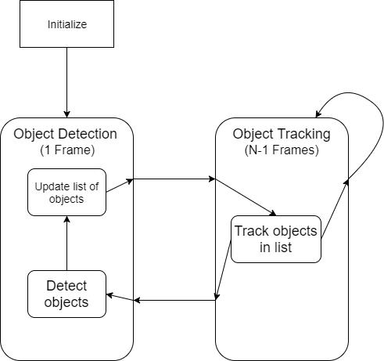
Incorporating Tracking
With OpenCV, tracking is fairly straightforward.
Preservation of ID is more complicated.
In detection phase, compare detections to list of objects.
If object doesn’t exist, add to new list.
Remove trackers that don’t match up with any detected objects.
Notes:
With a tracking method selected, it then needed to be incorporated into the project. This is fairly straight forward with opencv. You just need to initialize an instance of the tracker with the bounding box and the frame, and regularly update it with the new frame received from the camera. Tracking occurs every N-1 frames, and the remaining frame uses the detection method described earlier to update the tracker with clean information.
If we did not care about preserving an ID, this would be complete. However, with ID preservation, there needs to be a way for IDs to be persistent through a frame of detection. In order to do this, a list of detected objects is kept. With each object, a location, a class, a score, and a tracker instance are kept. In each detection step, each object detected is compared to the list of existing objects. If this box is reasonably close to the box of an existing object, that object is updated. Otherwise, the new object is added to the list, and a tracker is initialized. After all the new detections are processed, any object that was in the list but not updated gets removed from the list.
During object tracking frames, each tracker instance is run, updating the box stored with the object.

Slide 21
Results and Conclusions

Slide 22
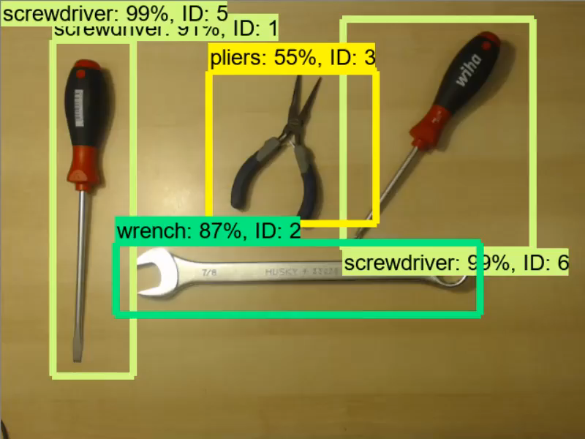
Real-Time Detection (Tracking)

Slide 23
Results
Collected and labeled new, tool-specific dataset
Used transfer learning to modify MobileNet-SSD classifier trained on the COCO dataset, for our tool dataset.
Implemented real-time object detection using self-trained model.
50 FPS average
Incorporated medianflow-based tracking to improve fps and incorporate ID persistence.
110 FPS average, one object tracked.

Slide 24
Places to Improve
Detection
Artificially grow dataset with data augmentation
Apply rotations, translations, flipping, and rescaling
Wider variety of training images
More quantitative evaluation techniques
Precision-recall curve
F1 score
Tracking
Utilize more complex methods for tracking
Only managed to get KCF, medianflow working
Medianflow is not as robust as other methods
Improve ID incrementing logic.
A number of parameters to tune that may make for more consistent IDs.
Notes:
Scale
Background
Some Tracking parameters include: margin of error between boxes before it’s considered a different box, maybe even using a different distance measurement between boxes (currently using max distance, but could use a 4 coordinate Euclidian/l2 norm), number of frames that

Slide 25
Future Work
Create a more complete training dataset.
More classes of tools
Explore alternate detection frameworks.
Inception V2 + Resnet
More exploration of tracking methods.
Goturn, TLD, KCF in practice
Hyperparameter tuning
Develop a user-facing frontend
Allow user to train new tools, train on their own tools.

Slide 26

Any Questions?

